Slide 1
Hidden Surface Removal

Slide 2
Visibility
Assumption: All polygons are opaque
What polygons are visible with respect to your view frustum?
Outside: View Frustum Clipping
Remove polygons outside of the view volume
For example, Liang-Barsky 3D Clipping
Inside: Hidden Surface Removal
Backface culling
Polygons facing away from the viewer
Occlusion
Polygons farther away are obscured by closer polygons
Full or partially occluded portions
Why should we remove these polygons?
Avoid unnecessary expensive operations on these polygons later

Slide 3
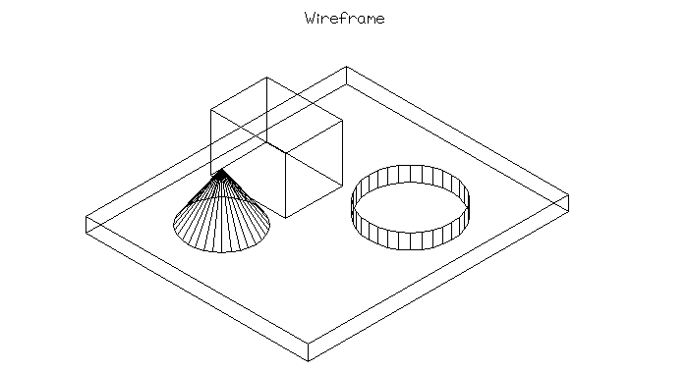
No Lines Removed

Slide 4
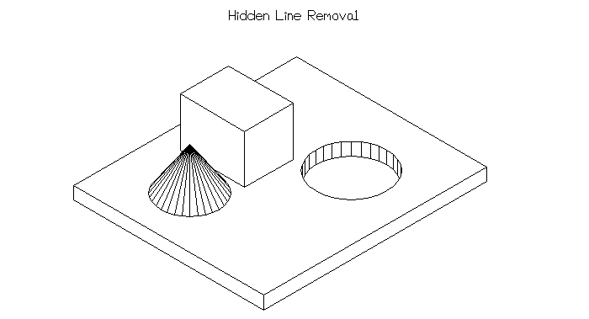
Hidden Lines Removed

Slide 5
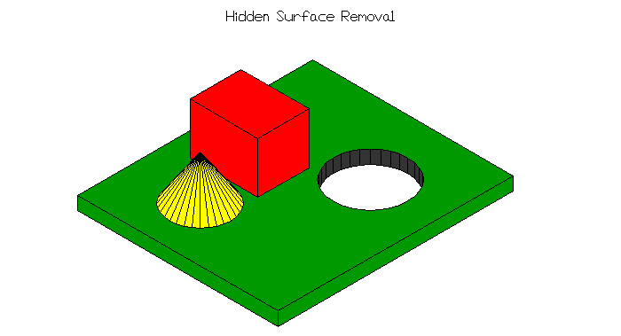
Hidden Surfaces Removed

Slide 6
Occlusion: Full, Partial, None
Full
Partial
None
The rectangle is closer than the triangle
Should appear in front of the triangle

Slide 7
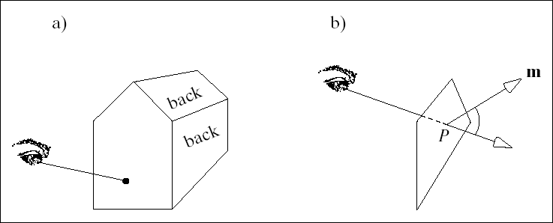
Backface Culling
Avoid drawing polygons facing away from the viewer
Front-facing polygons occlude these polygons in a closed polyhedron
Test if a polygon is front- or back-facing?
back-facing
Ideas?
front-facing

Slide 8
Detecting Back-face Polygons
The polygon normal of a …
front-facing polygon points towards the viewer
back-facing polygon points away from the viewer
If (n • v) > 0 ⇒ “back-face”
If (n • v) ≤ 0 ⇒ “front-face”
v = view vector
Eye-space test … EASY!
“back-face” if n_{z} < 0
glCullFace(GL_BACK)
back
front

Slide 9
Polygon Normals
Let polygon vertices v₀, v₁, v₂,..., v_{n - 1} be in counterclockwise order and co-planar
Calculate normal with cross product:
n = (v₁ - v₀) X (v_{n - 1} - v₀)
Normalize to unit vector with n/║n║
n
v₃
v₂
v₄
v₀
v₁

Slide 10
Normal Direction
Vertices counterclockwise ⇒ Front-facing
Vertices clockwise ⇒ Back-facing
2
1
0
0
1
2
Front facing
Back facing

Slide 11
Painter’s Algorithm (1)
Assumption: Later projected polygons overwrite earlier projected polygons
Graphics Pipeline
3
2
1
3
2
1
Oops! The red polygon
Should be obscured by
the blue polygon

Slide 12
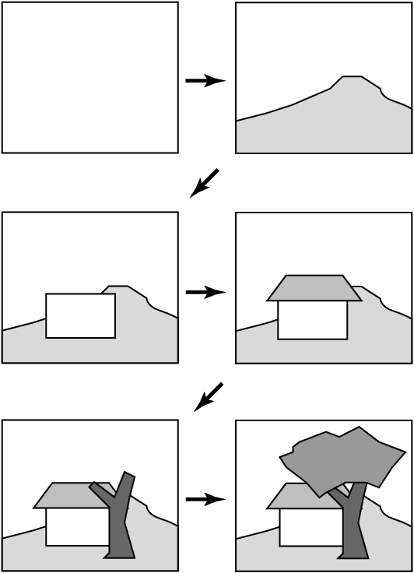
Painter’s Algorithm (2)
Main Idea
A painter creates a picture by drawing background scene elemens before foreground ones
Requirements
Draw polygons in back-to-front order
Need to sort the polygons by depth order to get a correct image
from Shirley

Slide 13
Painter’s Algorithm (3)
Sort by the depth of each polygon
Graphics Pipeline
3
2
1
3
2
1
depth

Slide 14
Painter’s Algorithm (4)
Compute z_{min} ranges for each polygon
Project polygons with furthest z_{min} first
(z) depth
z_{min}
z_{min}
z_{min}
z_{min}

Slide 15
Painter’s Algorithm (5)
Problem: Can you get a total sorting?
z_{min}
z_{min}
z_{min}
z_{min}
Correct?

Slide 16
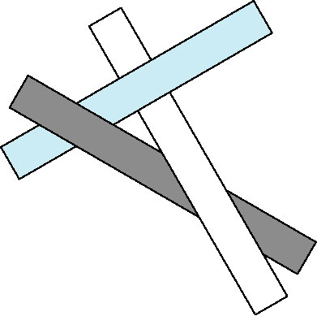
Painter’s Algorithm (6)
Cyclic Overlap
How do we sort these three polygons?
Sorting is nontrivial
Split polygons in order to get a total ordering
Not easy to do in general

Slide 17
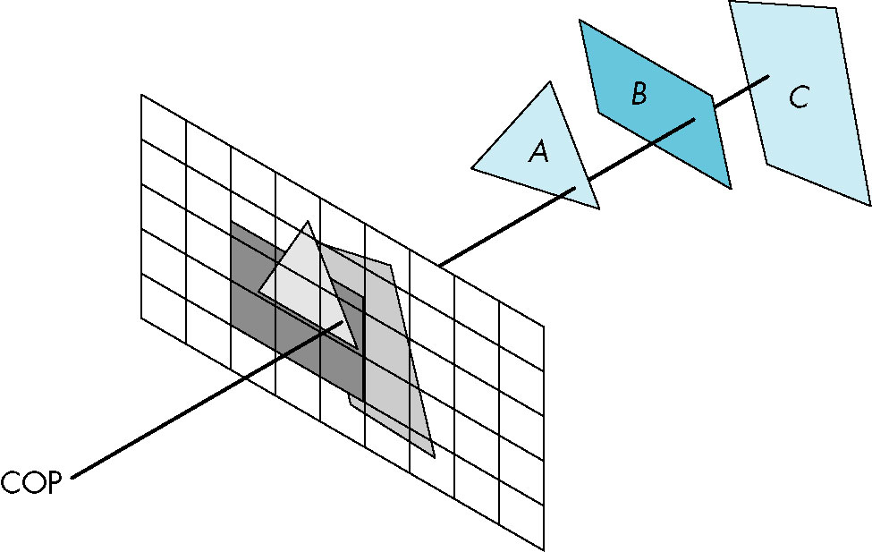
Visibility
How do we ensure that closer polygons overwrite further ones in general?

Slide 18
Z-Buffer
Depth buffer (Z-Buffer)
A secondary image buffer that holds depth values
Same pixel resolution as the color buffer
Why is it called a Z-Buffer?
After eye space, depth is simply the z-coordinate
Sorting is done at the pixel level
Rule: Only draw a polygon at a pixel if it is closer than a polygon that has already been drawn to this pixel

Slide 19
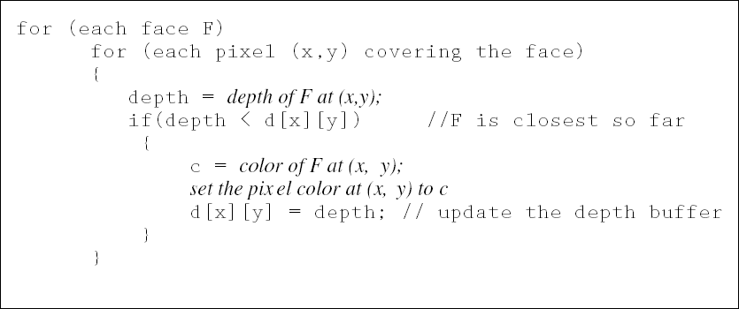
Z-Buffer Algorithm
Visibility testing is done during rasterization

Slide 20
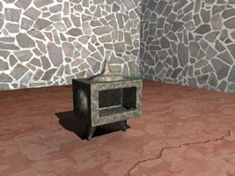
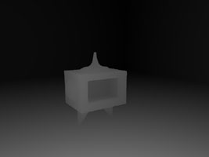
Z-buffer: A Secondary Buffer
DAM Entertainment
Color buffer
Depth buffer

Slide 21
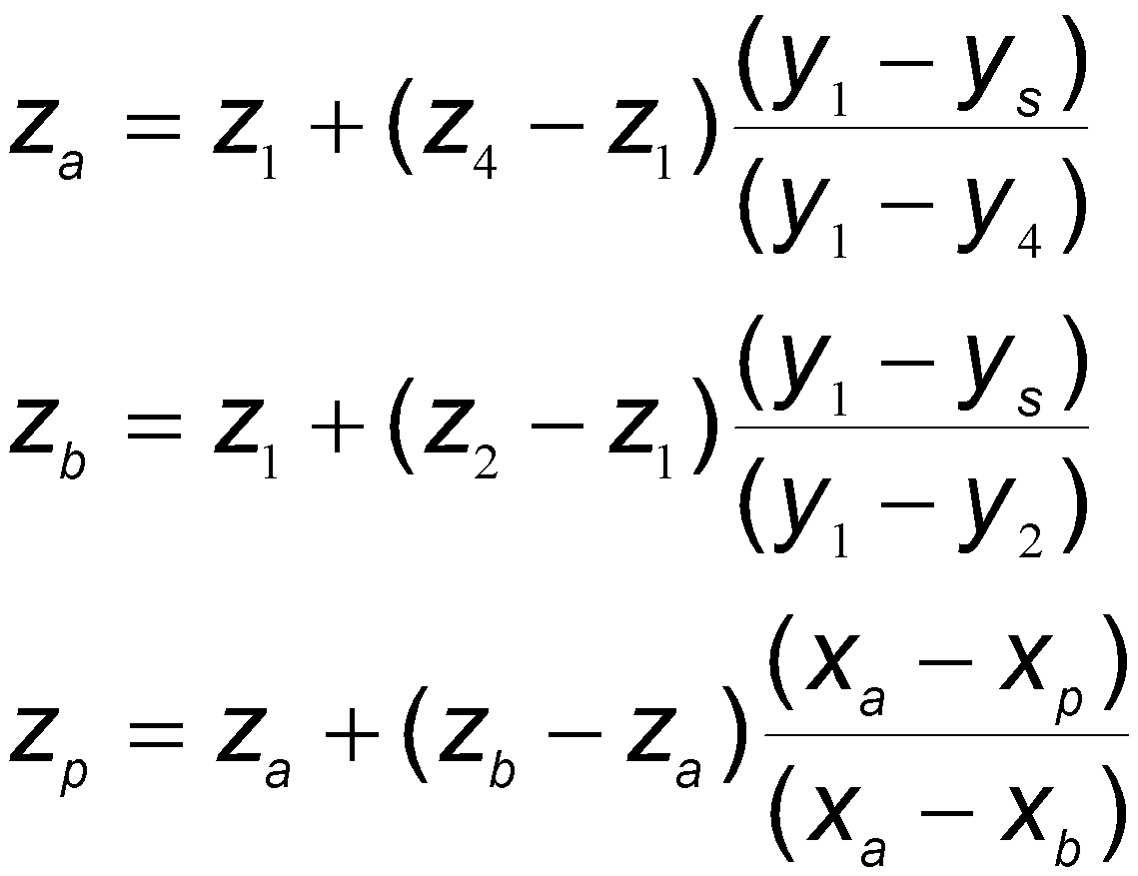
Z-Buffer
How do we calculate the depth values on the polygon interior?
P₃
P₄
Scanline order
P₂
y_{s}
z_{a}
z_{p}
z_{b}
Bilinear Interpolation
P₁

Slide 22
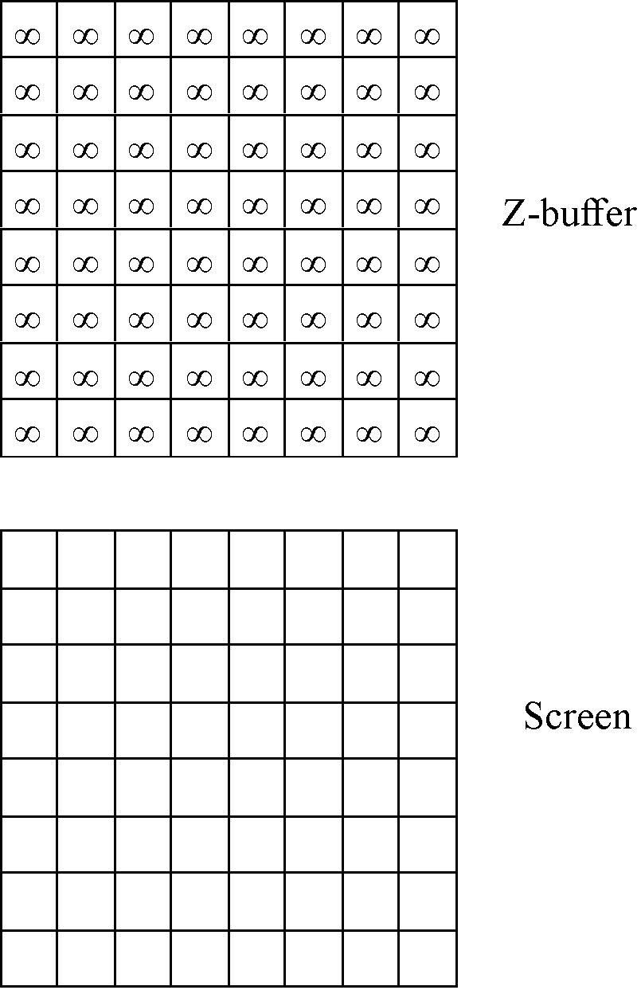
Z-buffer - Example

Slide 23
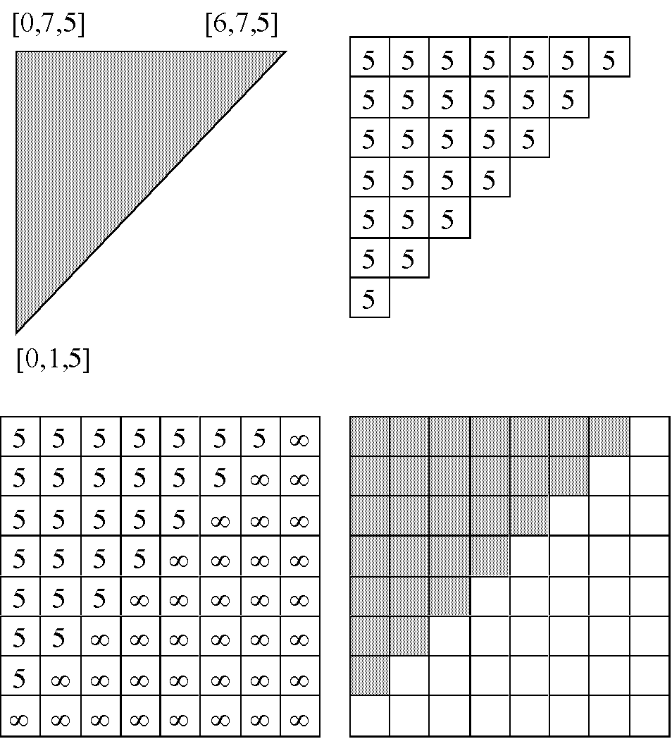
Parallel with
the image plane

Slide 24
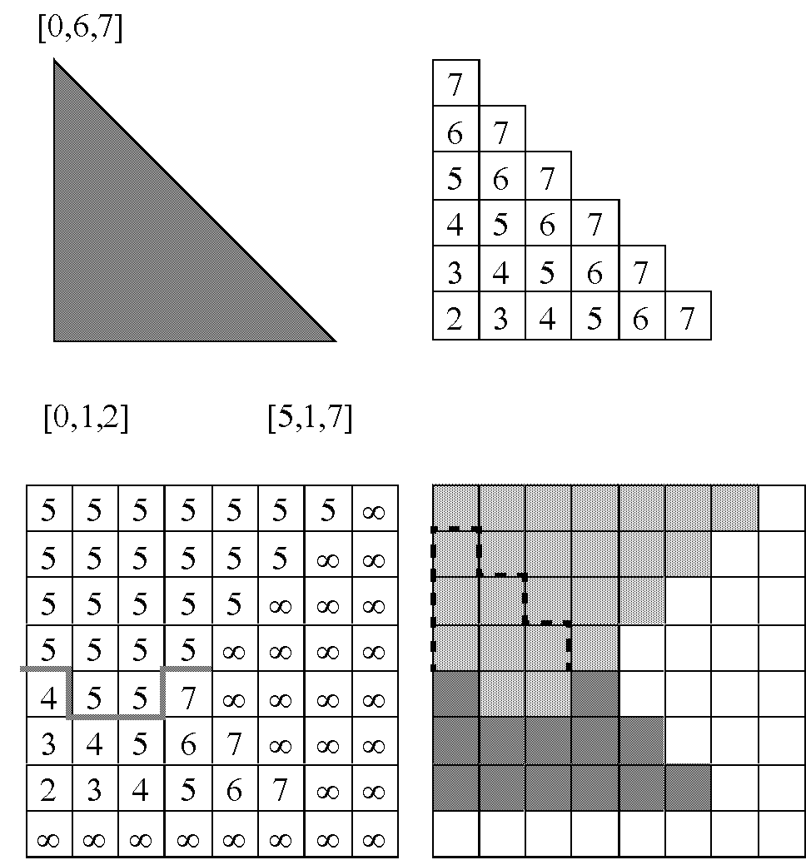
Not Parallel

Slide 25
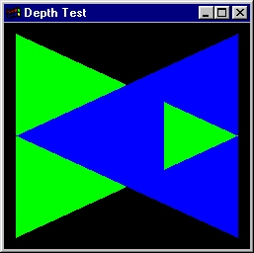
Z-Buffer Algorithm
Algorithm easily handles this case

Slide 26
Z-buffering in OpenGL
Create depth buffer by setting GLUT_DEPTH flag in glutInitDisplayMode()or the appropriate flag in the PIXELFORMATDESCRIPTOR.
Enable per-pixel depth testing with glEnable(GL_DEPTH_TEST)
Clear depth buffer by setting GL_DEPTH_BUFFER_BIT in glClear()

